Slide 1
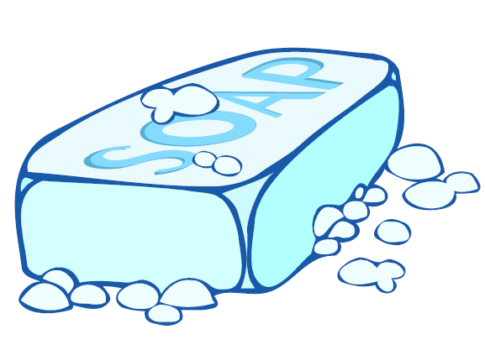
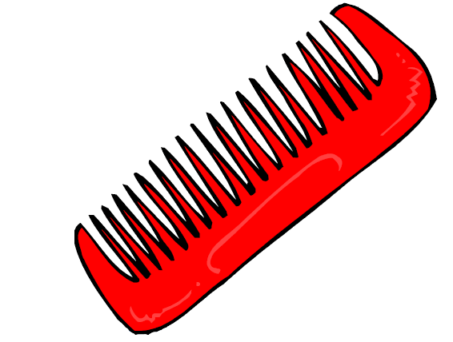
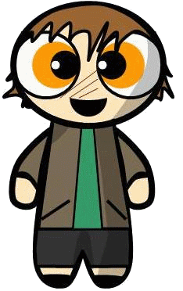
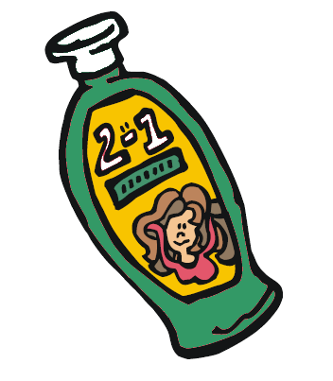
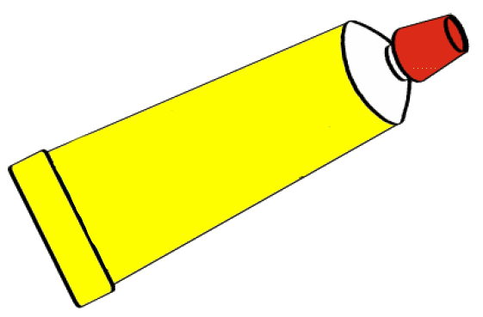
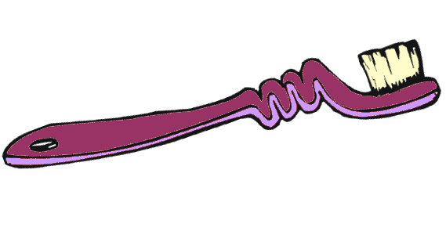
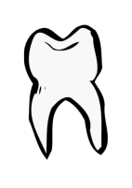
HAVE YOU SEEN MY...?
Nicolas Brunette
Catherine Gauthier
Émilie Lefebvre
Jessica Richard

Slide 2
Hello! My name is Timmy.
In my bathroom...

Slide 3
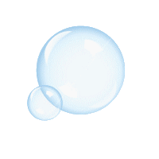
My soap bar is white and bubbly.

Slide 4
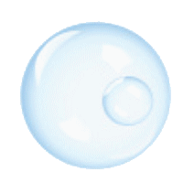
My towel is orange and rectangular.

Slide 5
My toothbrush is long and purple.

Slide 6
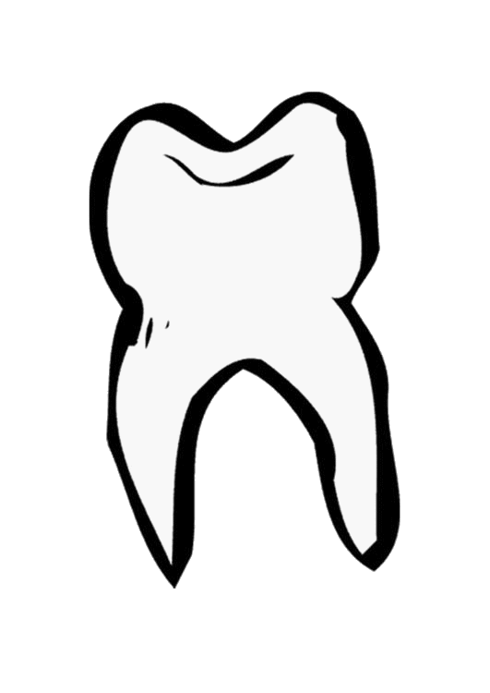
My toothpaste is yellow.

Slide 7
My comb is big and red.

Slide 8
My shampoo is green.

Slide 9
My yellow duck is small and funny.

Slide 10
Goodbye!

Slide 11
HAVE YOU SEEN MY...?
Nicolas Brunette
Catherine Gauthier
Émilie Lefebvre
Jessica Richard

Slide 12
Hello! My name is Timmy.
Help me find my objects in the bathroom!
Have you seen my...?

Slide 13
My soap bar is white and bubbly.

Slide 14
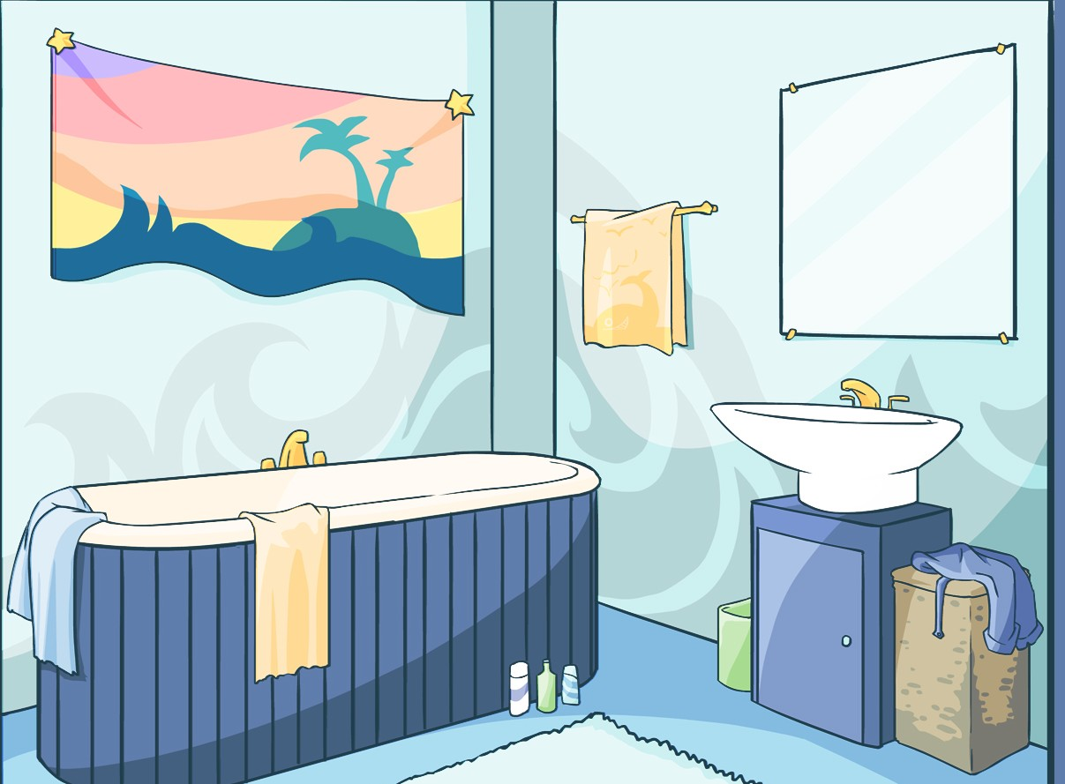
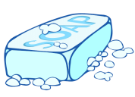
Have you seen
my soap bar?

Slide 15
My towel is orange and rectangular.

Slide 16
Have you seen
my towel?

Slide 17
My toothbrush is long and purple.

Slide 18
Have you seen
my toothbrush?

Slide 19
My toothpaste is yellow.

Slide 20
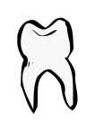
Have you seen
my toothpaste?

Slide 21
My comb is big and red.

Slide 22
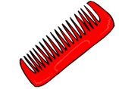
Have you seen
my red comb?

Slide 23
My shampoo is green.

Slide 24
Have you seen
my shampoo?

Slide 25
My yellow duck is small and funny.

Slide 26
Have you seen
my yellow duck?

Slide 27
Thank you!

Slide 28
HAVE YOU SEEN MY...?
L e t ’ s s i n g !
Nicolas Brunette
Catherine Gauthier
Émilie Lefebvre
Jessica Richard

Slide 29
Have You Seen My...?
My soap bar is white and bubbly
Have you seen my soap bar ?
Have you seen my soap bar ?
Have you seen my soap bar ?
Have you seen my soap bar ?
My towel is orange and rectangle
Have you seen my towel ?
Have you seen my towel ?
Have you seen my towel ?
Have you seen my towel ?
My toothbrush is long and purple
Have you seen my toothbrush ?
Have you seen my toothbrush ?
Have you seen my toothbrush ?
Have you seen my toothbrush ?
My toothpaste is yellow
Have you seen my toothpaste ?
Have you seen my toothpaste ?
Have you seen my toothpaste ?
Have you seen my toothpaste ?
My comb is big and red
Have you seen my red comb ?
Have you seen my red comb ?
Have you seen my red comb ?
Have you seen my red comb ?
My shampoo is green
Have you seen my shampoo ?
Have you seen my shampoo ?
Have you seen my shampoo ?
Have you seen my shampoo ?
My yellow duck is small and funny
Have you seen my yellow duck ?
Have you seen my yellow duck ?
Have you seen my yellow duck ?
Have you seen my yellow duck ?

